Slide 1

Non Essential and Toxic Elements
Rohan Singh
Ramjas College, University of Delhi
B.Sc. (Hons) Chemistry, 2021

Slide 2
Non-Essential Elements
Elements that do not play any active role in biological systems and life processes are categorized under Non-Essential Elements.
Common examples of non-essential elements are Aluminium (Al), Silicon (Si), Titanium (Ti), Zirconium (Zr), Strontium (Sr), Barium (Ba) and Tin (Sn).
Absence of these elements do not cause any major effect on the biological system. Other essential elements can emulate their behaviour and serve their purpose.
Since most of non-essential elements forms insoluble oxides at biological pH and unstable complexes with complexing agents of biological significance, they are non-toxic are normal levels.
However like all elements, they can be toxic at very high levels.

Slide 3
Abundance of Non Essential Elements
Most of the non-essential elements are fairly abundant in earth crust. It is represented in following in chart.

Slide 4
Toxic Elements
Toxicity is the measure of extent to which a substance can damage an organism. An element is considered as toxic if it impart negative effects on biological system and crucial life processes.
In general, every element is toxic at very high level. However some elements are toxic even in trace amounts. These elements are called Toxic Elements.
Most common examples of toxic elements are Mercury (Hg), Cadmium (Cd), Lead (Pb) and Arsenic (As).
Toxicity of elements is mainly due to
Blocking of essential functional groups of biomolecules, like –OH of serine, -SH of Cysteine, -N of histidine etc in amino acids residues, proteins and enzymes.
Displacement of essential metal ions in biomolecules.
Modification of active confirmation of biomolecules that render them inactive.

Slide 5
Abundance of Toxic Elements
Most of the toxic elements are very rare in earth crust. It is represented in following in chart.

Slide 6
Mercury (Hg)
Sources of pollution :: Industrial waste, Mining (Hg is trace component of many minerals), Pesticides, coal and lignite (≈100 ppm of Hg).
Cause of Toxicity :: Strong affinity (formation constant of 10¹⁶-10²²) for deprotonated thiol (-SH) group of cysteine residue that make’s up active site of many proteins and enzymes. That is why –SH is also known as mercaptan (mercurium captans). Hg⁺² is a soft acid while S of -SH is soft base so Hg⁺² strongly binds with S (strong soft acid-soft base interaction) and changes active confirmation of biomolecule.
Toxic Effects :: Hg is toxic by ingestion and inhalation, and toxicity depends upon chemical form. Inorganic soluble Hg salts are highly toxic that can cause corrosion of intestinal tract, kidney failure and even death.
Incidents :: Minamata disease in Japan in 1953-60 that is caused by Hg containing catalytic effluent released by Minimata Chemical company into Minamata Bay. 111 people who fed on contaminated fish from bay were reported of Hg poisoning of which 45 died.

Slide 7
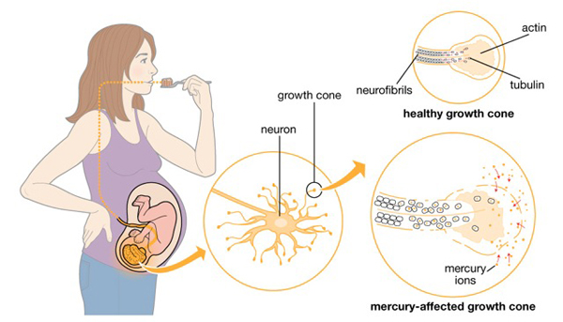

Another tragic incident occurred in Iraq in 1972, in which 450 people died after eating wheat dusted with Hg containing pesticides.
Effect of Hg on fetus growth
Minimata Disease

Slide 8
Cadmium (Cd)
Sources of pollution :: Metallurgical plants, Cd plating and battery fabricators.
Cause of Toxicity :: Cd is similar to Zn (Found naturally in association with Zn). Cd⁺² can displace Zn⁺² in many biomolecules. Cd⁺² like Hg⁺², can strongly bind to -SH of cysteine residue and alter active confirmation of enzymes and proteins like carbonic anhydrase, carboxy peptidase and dipeptidase.
Toxic Effects :: Acute Cd poisoning can cause nausea, vomiting, diarrhea and abdominal pain. Chronic Cd poisoning can cause brittleness of bones.
Incidents :: Ouch-Ouch (or Itai-Itai) Disease along Jinstu river in West Japan, caused by chronic Cd poisoning due to which, around 100 people died. Cause of this incident was a unused Zn mine along river, that contaminated river water with Cd. Water from river was used for irrigation of rice. Thereby, Cd manifested in people who ate contaminated rice.

Slide 9
Lead (Pb)
Sources of pollution :: Battery Industry, Leaded gasoline (90% lead in atmosphere) that uses tetraethyl lead (TEL) as anti knocking agent.
Causes of Toxicity :: (C₂H₅)₃Pb⁺ formed by combustion of leaded gasoline can penetrate permeable membranes like blood-brain membrane. Like Hg⁺² and Cd⁺², Pb⁺² can also inhibit –SH enzymes (but less strongly). Main cause of toxicity is ability of Pb to inhibit key enzymes in heme synthesis.
Toxic Effects :: (C₂H₅)₃Pb⁺ can cause several disorders of central and peripheral nervous system like cramps, paralysis and loss of coordination. Primary toxic effect of Pb poisoning is anemia as it inhibits heme synthesis and reduces healthy red blood cell count in blood.

Slide 10
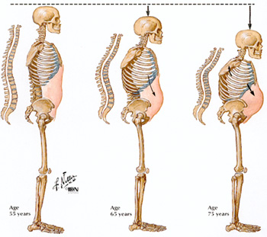
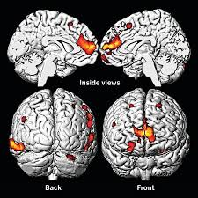
Penetration of (C₂H₅)₃Pb⁺ in brain
Itai-Itai Disease

